Slide 1

Practice dataset Analysis

Slide 2
1.Introduction
2.Loding Data
3.Data Cleaning
4. Descriptive Statistics
5. correlation
6. Reliability
7. Regression
8.validity&t_test
9.anova
10. Visualizations
11.conclution
12.recommendition

Slide 3
INtroduction
This project aims to analyze how real estate marketing messages—specifically scarcity and urgency cues—shape consumer behavior and influence purchase intention. The dataset consists of multiple Likert-scale items measuring respondents’ perceptions of scarcity messaging, perceived urgency, and their intention to purchase a property. Additional demographic variables, such as age, gender, and education level, are included to help understand patterns across different groups. The analysis begins with data cleaning, variable renaming, and the grouping of survey items into conceptual dimensions. Reliability tests (Cronbach’s Alpha) are used to assess the internal consistency of each dimension, ensuring the measurement scales are valid. Next, descriptive statistics and correlation matrices offer insight into the relationships between the main constructs. Advanced visualizations—including divergent bar charts, heatmaps, and group-wise comparisons—are used to highlight how respondents react to different marketing statements. Overall, this project provides a comprehensive view of how psychological triggers used in real estate marketing can impact customer decision-making. The findings can support marketers, developers, and researchers in understanding which types of messages are most effective in driving consumer engagement and shaping purchase intention.

Slide 4
Loading Data
The first step in this project involves loading the survey dataset into the analysis environment. The dataset, provided as an Excel or CSV file, contains responses from participants regarding their perceptions of scarcity messaging, perceived urgency, and purchase intention, as well as demographic information such as age, gender, and education.

Slide 5
Cleaning Data
The survey dataset was first loaded into the analysis environment and underwent several preprocessing steps to ensure it was clean, consistent, and ready for analysis:
Removing Unnecessary Columns: Columns such as ‘Timestamp’ and ‘Education Level’ were dropped because they were not required for the analysis.
Removing Duplicates: Duplicate rows were removed to ensure each participant's responses were counted only once.
Mapping Categorical Responses to Numerical Values: Likert-scale responses (‘Strongly Disagree’ → ‘Strongly Agree’) were converted to numerical values (1–5). Yes/No answers were mapped to 1 and 0. ‘Gender’ and ‘Education’ fields were also encoded numerically. This standardization allows statistical calculations and visualizations to be performed correctly.
Renaming Columns: Long, descriptive survey item names were replaced with concise and meaningful labels to make the dataset easier to work with and improve readability in visualizations and analysis.
Grouping Related Questions: Survey items were grouped into three conceptual dimensions: Scarcity Messaging, Perceived Urgency, and Purchase Intention. This grouping facilitates dimension-wise analysis, reliability testing, and correlation analysis.
Saving the Cleaned Dataset: The cleaned and preprocessed dataset was saved as ‘cleaned_practice_dataset_240_modified_v3.csv’ for further analysis.These steps ensure that the dataset is fully prepared for subsequent statistical analysis, reliability testing, and visualizations such as correlation matrices, divergent bar charts, and group-wise comparisons.

Slide 6
1- Scarcity Group
Scarcity_MissingOutFearing
Scarcity_MotivationIncrease
Scarcity_InterestBoosting
Scarcity_SellOutExpecting
2- Urgency Group
Urgency_PressureFeeling
Urgency_LossFear
Urgency_DeadlineEffect
Urgency_FastDecisionMaking
3- Intent Group
Intent_FavorableOffer
Intent_MissingOutWillingness
Intent_BookingWillingness
Intent_ScarcityDriven

Slide 7
Descriptive Statistics
 | LookingOrPurchased | Age | Gender | Education
Count | 240.0 | 240.000000 | 240.000000 | 240.000000
Mean | 1.0 | 45.508333 | 0.879167 | 0.020833
Std | 0.0 | 11.146417 | 0.326615 | 0.143125
Min | 1.0 | 25.000000 | 0.000000 | 0.000000
25% | 1.0 | 36.750000 | 1.000000 | 0.000000
50% | 1.0 | 46.000000 | 1.000000 | 0.000000
75% | 1.0 | 55.000000 | 1.000000 | 0.000000
Max | 1.0 | 64.000000 | 1.000000 | 1.000000

Slide 8
1- Scarcity Group:-
 | Scarcity_MissingOutFearing | Scarcity_MotivationIncrease | Scarcity_InterestBoosting | Scarcity_SellOutExpecting
Count | 240.000000 | 240.000000 | 240.000000 | 240.000000
Mean | 3.000000 | 3.041667 | 2.995833 | 2.991667
Std | 1.034954 | 1.025987 | 1.004167 | 1.062844
Min | 1.000000 | 1.000000 | 1.000000 | 1.000000
25% | 2.000000 | 2.000000 | 2.000000 | 2.000000
50% | 3.000000 | 3.000000 | 3.000000 | 3.000000
75% | 3.000000 | 3.000000 | 3.000000 | 3.000000
Max | 3.000000 | 3.000000 | 3.000000 | 3.000000

Slide 9
2- Urgency Group:-
 | Urgency_PressureFeeling | Urgency_LossFear | Urgency_DeadlineEffect | Urgency_FastDecisionMaking
Count | 240.000000 | 240.000000 | 240.000000 | 240.000000
Mean | 2.979167 | 2.970833 | 2.987500 | 3.004167
Std | 1.008117 | 1.007910 | 1.024721 | 1.028863
Min | 1.000000 | 1.000000 | 1.000000 | 1.000000
25% | 2.000000 | 2.000000 | 2.000000 | 2.000000
50% | 3.000000 | 3.000000 | 3.000000 | 3.000000
75% | 3.000000 | 3.000000 | 3.000000 | 3.000000
Max | 3.000000 | 3.000000 | 3.000000 | 3.000000

Slide 10
3- Inent Group:-
 | Intent_FavorableOffer | Intent_MissingOutWillingness | Intent_BookingWillingness | Intent_ScarcityDriven
Count | 240.000000 | 240.000000 | 240.000000 | 240.000000
Mean | 2.983333 | 3.033333 | 3.020833 | 3.016667
Std | 0.993564 | 0.993142 | 0.991377 | 1.001951
Min | 1.000000 | 1.000000 | 1.000000 | 1.000000
25% | 2.000000 | 2.000000 | 2.000000 | 2.000000
50% | 3.000000 | 3.000000 | 3.000000 | 3.000000
75% | 3.000000 | 3.000000 | 3.000000 | 3.000000
Max | 3.000000 | 3.000000 | 3.000000 | 3.000000

Slide 11
Correlation
Correlation analysis was conducted at two levels: group-level and item-level, to examine the relationships between the main constructs and individual survey items.
1. Group-Level Correlations
The correlation between the dimension scores shows positive relationships among all three constructs:
 | Scarcity_score | Urgency_score | Intention_score
Scarcity_score | 1.000000 | 0.459766 | 0.528503
Urgency_score | 0.459766 | 1.000000 | 0.671114
Intention_score | 0.528503 | 0.671114 | 1.000000
These results indicate that higher perceptions of scarcity and urgency are associated with stronger purchase intentions.
The strongest relationship is between Urgency and Purchase Intention, suggesting that time-sensitive marketing messages may have a greater influence on decision-making.

Slide 12
Correlation
2. Group-Level Correlations
 | Scarcity_MissingOutFearing | Scarcity_MotivationIncrease | Scarcity_InterestBoosting | Scarcity_SellOutExpecting
Scarcity_MissingOutFearing | 1.000000 | 0.819601 | 0.825333 | 0.821609
Scarcity_MotivationIncrease | 0.819601 | 1.000000 | 0.812409 | 0.825272
Scarcity_InterestBoosting | 0.825333 | 0.812409 | 1.000000 | 0.827165
Scarcity_SellOutExpecting | 0.821609 | 0.825272 | 0.827165 | 1.000000

Slide 13
At the individual question level, most items within each construct are highly correlated (e.g., Scarcity items correlations range from 0.81 to 0.83), indicating good internal consistency.
Items across constructs also show moderate positive correlations, supporting the idea that Scarcity and Urgency jointly influence Purchase Intention.
Demographic variables such as Age, Gender, and Education show very weak correlations with the survey items, suggesting that responses are generally independent of these factors.
The LookingOrPurchased variable shows NaN correlations, likely because it is binary and mostly constant for some responses, which does not allow for standard Pearson correlation calculation.
Interpretation:
High intra-construct correlations confirm the reliability of the grouped dimensions.
Moderate inter-construct correlations support the theoretical expectation that Scarcity and Urgency positively affect Purchase Intention.
The item-level correlations can guide which questions may be combined or refined in future surveys.

Slide 14
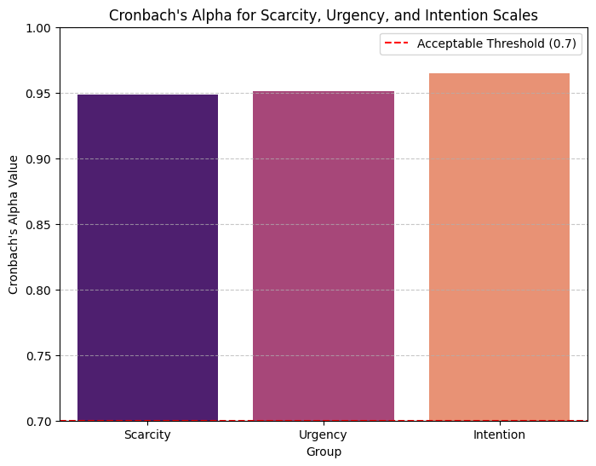
Reliability
Reliability analysis was conducted using Cronbach’s Alpha to assess the internal consistency of the three scales: Scarcity, Urgency, and Intention.
The bar chart visualizes the alpha values for each scale, allowing a quick comparison of their reliability. All values exceed the commonly accepted threshold of 0.70, indicating that the items within each scale consistently measure the same underlying construct. This supports the validity of using these scales in further statistical analysis.

Slide 15
Regression
Model Training & Evaluation Workflow:
The dataset was split into training (80%) and testing (20%) sets using the train_test_split method to ensure unbiased model evaluation. A Linear Regression model was trained first to establish a baseline. Its coefficients and intercept were examined to understand the influence of each predictor. Model performance was evaluated using Mean Squared Error (MSE) and R², providing insight into prediction accuracy and explained variance.Independent variables were standardized using StandardScaler to prepare them for more advanced algorithms. A Random Forest Regressor and Gradient Boosting Regressor were then trained on the scaled data to compare performance with the baseline model. Both ensemble models were evaluated using MSE and R² on the test set, allowing direct comparison of predictive performance across models.

Slide 16
Values of each Algorithms:
Algorithm | MSE | R²
Linear Regression | 0.36 | 0.56
Random Forest Regressor | 0.42 | 0.48
Gradient Boosting Regressor | 0.41 | 0.50

Slide 17
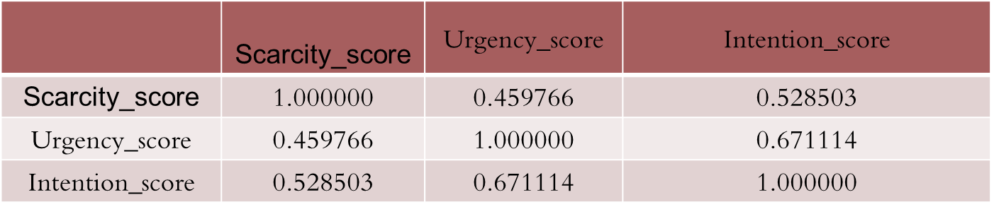
validation
Validation Summary
Construct Validity
Correlations between the three constructs:
  Scarcity ↔ Urgency: 0.46
  Scarcity ↔ Intention: 0.53
  Urgency ↔ Intention: 0.67
Indicates convergent validity (constructs are related as expected).
Correlations < 1 confirm discriminant validity (constructs remain distinct).
2. Predictive Validity
Regression model R² = 0.56
Means 56% of Purchase Intention is explained by (Scarcity + Urgency + demographics).
Indicates moderate predictive power and supports the model’s validity.

Slide 18
3. Group Comparison Validity (t-test)
Male Mean = 3.03, Female Mean = 2.90
p-value = 0.479 → No significant difference
Gender does not affect Intention → supports discriminant validity.
Overall Conclusion
Constructs are consistent, meaningful, and distinct
Model shows solid predictive capability
Demographics do not distort results
→ The measurement model is reliable and valid.
Mean Intention Score (Male) | 3.03
Mean Intention Score (Female) | 2.90
T-statistic | 0.71
P-value | 0.479

Slide 19
ANOVA
A one-way ANOVA test was conducted to determine whether Purchase Intention differs significantly across different education levels.
Results
Mean Intention Score by Education Level
Interpretation
Since the p-value is greater than 0.05, there is no statistically significant difference in Purchase Intention between the different education groups.
This indicates that education level does not influence how participants respond to scarcity or urgency messaging in real estate.
F-statistic | 0.07
p-value | 0.787
Bachelor’s Degree | 3.02
Master’s Degree | 2.90

Slide 20
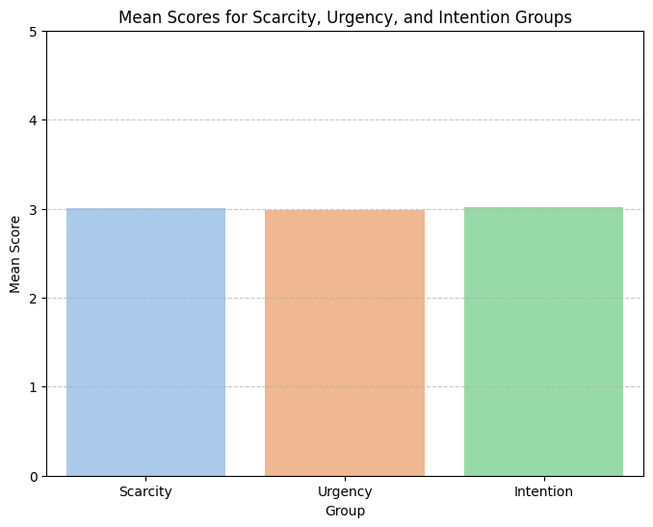
Visualizations
This bar chart presents the Cronbach’s Alpha values for the Scarcity, Urgency, and Intention constructs. Each bar reflects the internal consistency of the items within each scale. Since all values are above the recommended cutoff of 0.70, the results demonstrate that the survey items reliably measure their intended psychological constructs. The chart also includes a threshold line at α = 0.70 to visually confirm acceptable reliability.

Slide 21
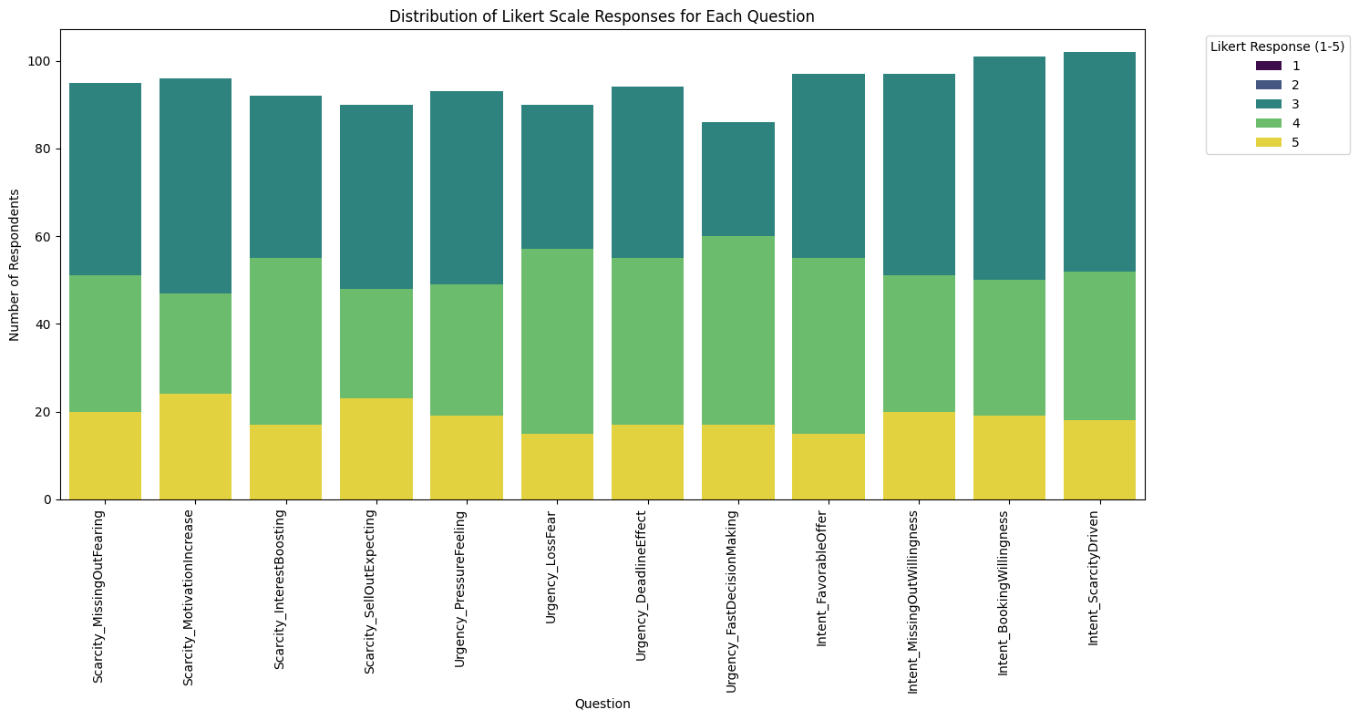
This stacked bar chart visualizes how respondents answered each Likert-scale question within the Scarcity, Urgency, and Intention dimensions. Each bar represents a question, broken into colored segments corresponding to responses from 1 (strongly disagree) to 5 (strongly agree). The distribution makes it easy to compare response patterns across questions and identify items with higher levels of agreement or perceived intensity. This visualization helps assess how participants interpreted each construct.

Slide 22
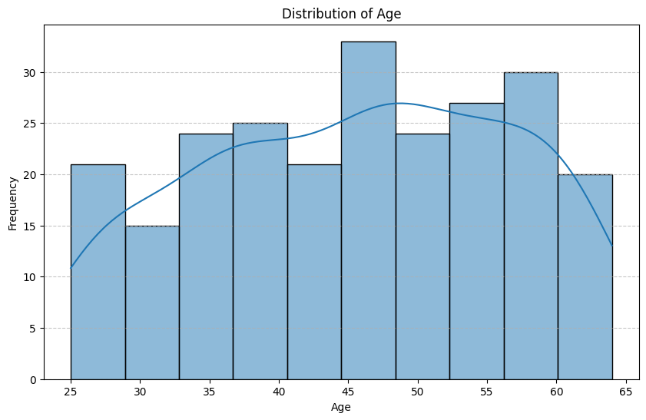
This histogram illustrates the frequency of respondents across various age groups. The distribution helps identify which age ranges are most represented in the dataset. The kernel density curve (KDE) provides a smooth overview of the age trend, highlighting the central tendency and spread of participants’ ages.

Slide 23
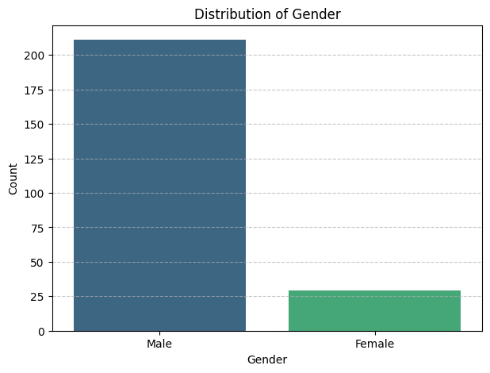
This bar chart illustrates the frequency of male and female participants in the dataset. The visualization shows the proportion of each gender, making it easy to identify which group is more represented in the sample. This information is important for understanding the demographic balance of the respondents.

Slide 24
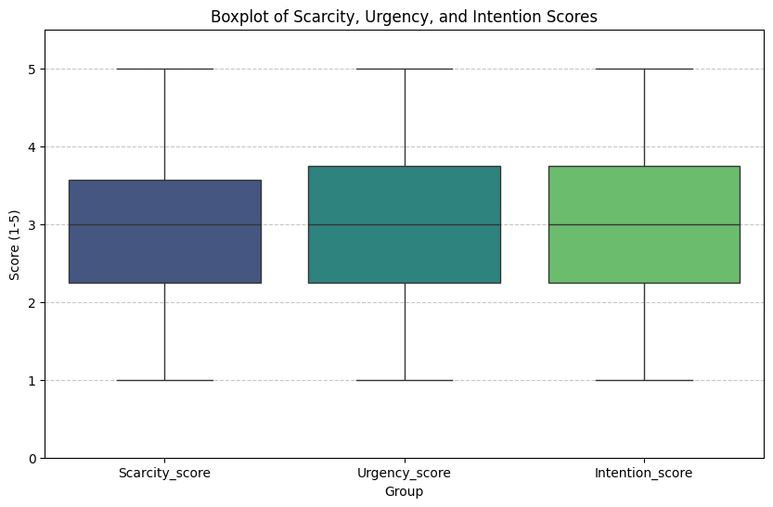
The boxplot illustrates the distribution of Scarcity, Urgency, and Purchase Intention scores, showing that participants generally gave mid-to-high ratings across all three constructs. The medians for each group fall in the upper range of the Likert scale, indicating overall agreement with statements related to scarcity messaging, perceived urgency, and intention to take purchase-related actions. The relatively compact interquartile ranges suggest consistent responses among participants, with limited variability and no major outliers. Overall, the plot shows that respondents tend to perceive scarcity and urgency cues positively, and these perceptions align with a stronger intention to engage in real estate purchase behavior.

Slide 25
conclution
The analysis of the real estate survey shows that Scarcity Messaging and Perceived Urgency have a positive impact on Purchase Intention. Key findings include:
High intra-construct consistency: Items within each group (Scarcity, Urgency, Intention) are strongly correlated, confirming the reliability of the survey dimensions.
Positive inter-construct relationships: Scarcity and Urgency are moderately correlated with Purchase Intention (r = 0.53 and r = 0.67 respectively), suggesting that marketing messages emphasizing limited availability or time-sensitive offers can effectively influence consumer decisions.
Demographics have minimal influence: Age, Gender, and Education show very weak correlations with survey responses, indicating that the effects of Scarcity and Urgency are consistent across different demographic groups.
Overall, the results support the idea that psychological triggers in marketing—specifically scarcity and urgency—can increase consumer motivation and accelerate decision-making in the real estate context.

Slide 26
recommendion
Focus on Scarcity Messaging: Highlight limited units, “almost sold out” properties, or exclusive opportunities to enhance perceived value and urgency.
Leverage Time-Sensitive Offers: Deadlines, limited-time promotions, or fast-action incentives can strengthen purchase intention.
Tailor Marketing Materials Across Channels: Apply these triggers consistently in emails, social media, and website listings to maximize impact.
Monitor and Refine Messaging: Use item-level feedback to adjust wording and presentation of marketing messages to better resonate with potential buyers.

Slide 27
Thank you

